Slide 1
What is Machine Learning?
Learning from Data
Learns the relationship between the variables of a system (input, output and hidden) from direct samples of the system (data)
Plenty of data and computational power can replace rule-based models to probabilistic data-driven modes
Learning from Big Data (scalable Learning)
Smart / Autonomous / Intelligent systems

Slide 2
Why Machine Learning?
There is no need to “learn” to calculate payroll etc….
No Machine Learning needed when the relationships between all system variables (input, output, and hidden) is completely understood! – known function
This is NOT the case for almost any real world system!

Slide 3

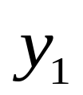

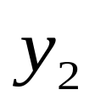
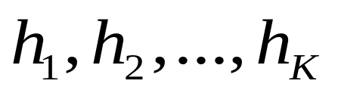
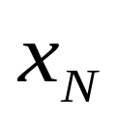
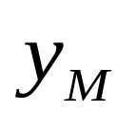
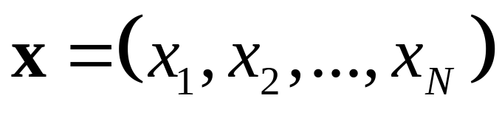
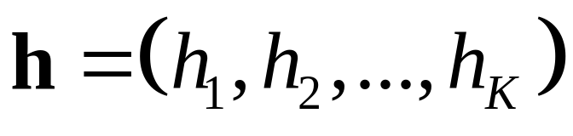
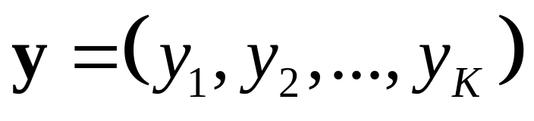
A Generic Real World System
System
…
…
Input Variables:
Hidden Variables:
Output Variables:

Slide 4
Machine Learning – Why?
When human expertise does not exist
Humans are unable to explain their expertise (speech recognition)
Some tasks cannot be defined well, except by examples (e.g., recognizing people).
Correlations and patterns can be hidden within large amounts of data.

Slide 5
Machine Learning – Why?
Amount of knowledge available about certain tasks might be too large for explicit encoding by humans (e.g., medical diagnostic).
Environment / solution change over time.
  Solution needs to be adapted to particular cases
Set of all possible behaviors given all possible inputs is too large
Process must generalize from the finite set of examples to produce an output / decision in new cases.

Slide 6
Learning from Data
Data may belong to any domain such as text, image, video, speech, Bio informatics etc.
Few Examples:
  Learning to recognize spoken words
  Learning to drive an autonomous vehicle
  Learning to classify new structures
  Learning to play games

Slide 7

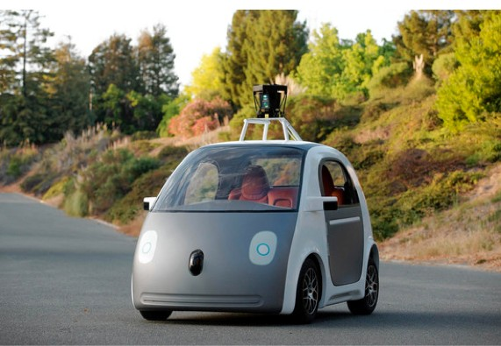
Driverless Vehicle
Learning to drive an autonomous vehicle
  Associate steering commands with image sequences
Google Prototype
Task T: driving on public, 4-lane highway using vision sensors
Perform measure P: average distance traveled
Training E: sequence of images and steering commands recorded while observing a human driver

Slide 8
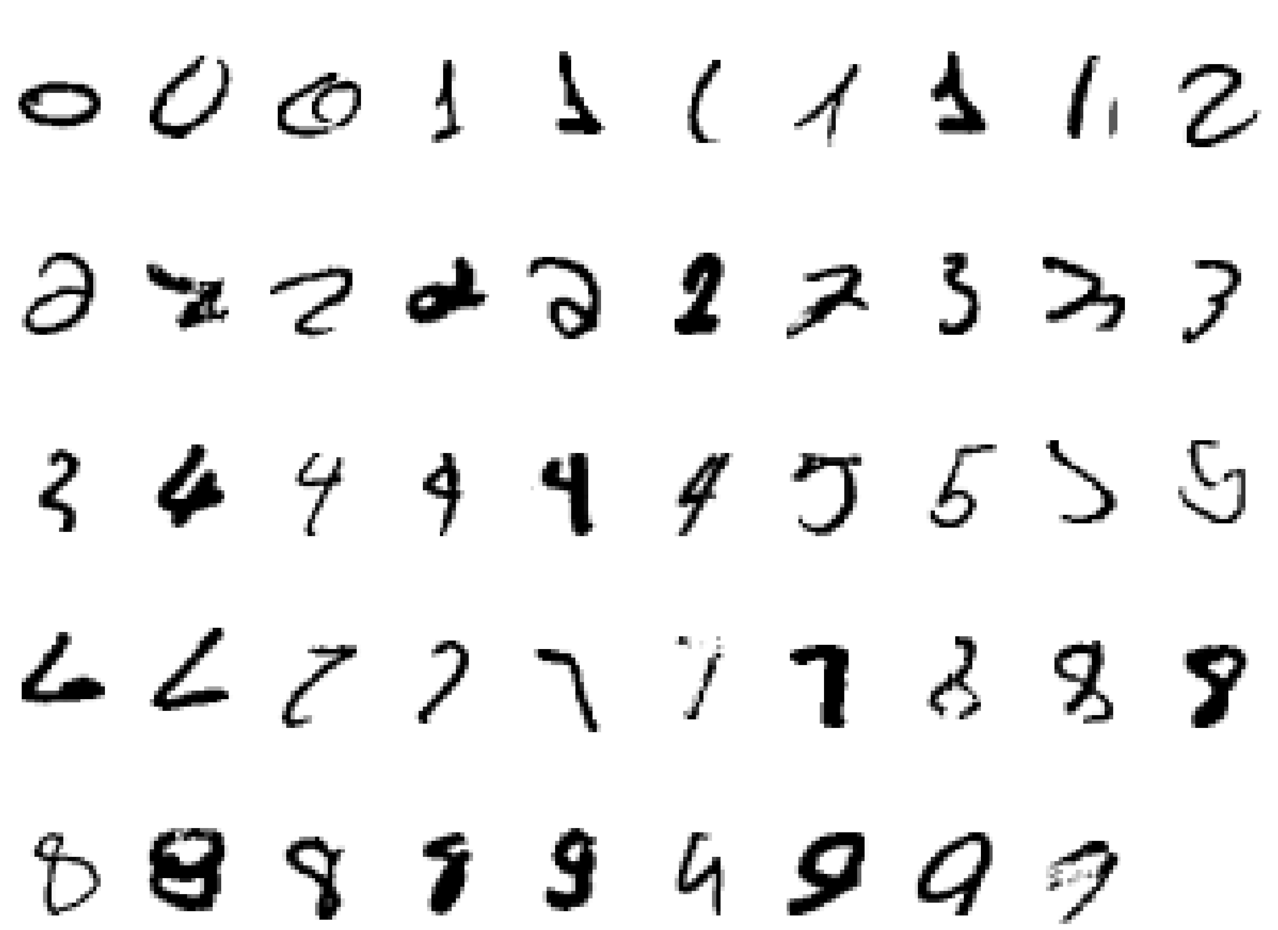
Handwritten character recognition
It is very hard to say what makes a “2”
Wide variability of same numeral
Handcrafted rules will result in large no of rules and exceptions
Better to have a machine that learns from a large training set

Slide 9








Face Recognition
Training examples of a person
Test images

Slide 10
Machine Learning Tasks
  Recognition / Classification
  Clustering
  Prediction / Regression
  Anomaly detection
  Retrieval

Slide 11
Other Applications
Recognizing patterns:
  Speech Recognition
  Facial identities or facial expressions
  Handwritten or spoken words
  Medical images
Recognizing anomalies:
  Unusual sequences of credit card transactions
  Unusual patterns of sensor readings in a nuclear power plant
  Video surveillance
Prediction:
  Future stock prices
  Sales prediction
Information Retrieval

Slide 12
Machine Learning – How?
Supervised learning
  Training data includes desired outputs
  classification, regression, outlier detection
Unsupervised learning
  Training data does not include desired outputs
  Grouping similar instances - clusters;
  Big Data don’t have labels.
Semi-supervised learning
  Training data includes a few desired outputs
Reinforcement learning
  Rewards or penalty from sequence of actions
  After a set of trial-and error runs, learns best policy - sequence of actions that maximize the total reward.

Slide 13
Machine Learning - Where?
Handwriting Recognition
  x: Data from pen motion.
  f(x): Letter of the alphabet.
Disease diagnosis
  x: Properties of patient (symptoms, lab tests)
  f(x): Disease (or recommended therapy)
Face recognition
  x: Bitmap picture of person's face
  f(x): Name of the person.
Spam Detection
  x: Email message
  f(x): Spam or not spam.
So many………

Slide 14
Machine Learning – How?
Data Representation
Choice of Similarity or Distance measure
Choice of Learning Algorithm

Slide 15
Machine Learning – How?
Raw data preprocessed to obtain a feature vector, X, that adequately describes all the relevant features for classifying examples
Each x is a list of (attribute, value) pairs. Example:
  X = [Person:Susan, EyeColor:Brown, Age:40, Sex:Female]
The number of attributes is fixed
Each attribute has discrete or continuous values
An example can be interpreted as a point in an n-dimensional feature space, where n is the number of attributes

Slide 16
Machine Learning – Techniques
Decision Tree induction
    Tree is constructed in a top-down recursive divide-and-conquer manner
    Simple rules
    Overfitting
Bayesian classifier
    Statistical classifier performs probabilistic prediction - predicts class membership probabilities based on Bayes Theorem
    Prior knowledge can be incorporated
    Easy implementation, Good results
    Dependence among attributes cannot be modeled – Bayesian Belief networks
Neural Networks
    Given enough hidden units and enough training samples, they can closely approximate any function
    Long training time
    Require a number of parameters typically best determined empirically
    Ability to classify untrained patterns
    Well-suited for continuous-valued inputs and outputs

Slide 17
Machine Learning Techniques
Lazy Learning : K- Nearest Neighbor
Gaussian mixture model GMM)
Adapted GMM
Hidden Markov model (HMM)
Support vector Machine (SVM)
Posterior probability SVM

Slide 18
Adaptive Learning
  1st generation: Rules
  Analyst creates rules - very time consuming and not very accurate, cannot adapt to new data
  2nd generation: Simple machine learning
  uses statistical methods to make decisions
  3rd generation: Deep learning
  learns more complex relationships between features. Automatically learns how to use combinations of features when making a decision.
  4th generation: Adaptive learning

Slide 19
Adaptive Learning
  Learning from changing environment / new data
  Algorithms for adaptively updating computed inferences (estimated parameters) of models where observed evidence, conditional probabilities, and the structure of the dependencies change over time

Slide 20
Machine Learning - Resources
UCI Machine Learning Repository
http://www.ml.cmu.edu/research/index.html
Journals :
IEEE
  Pattern Analysis and Machine Intelligence
  Systems, Man & cybernetics
  Knowledge & Data Engineering
  Neural Networks
  Signal Processing Letters
  Signal Processing Magazine
Elsevier
  Pattern Recognition
  Pattern Recognition Letters
  Neural Computation
  Signal Processing
  Signal Processing: Image Communication
  Applied Soft Computing
  Information Processing Letters
MIT - Journal of Machine Learning Research (JMLR)

Slide 21
Queries ???
THANK YOU !!!

